Slide 1
Non-negative matrix Factorization
Lab tutorial - 29.04.2022

Slide 2
Topics to cover
What is NMF
Why NM?
Use cases
Implementing NMF: Algorithms, initialisation, finding k
Practical part
Example 1 (clustering genetic data)
Example 2 (learning spatiotemporal structure of facial expressions)
Visualization
Tools and references
Limitations

Slide 3
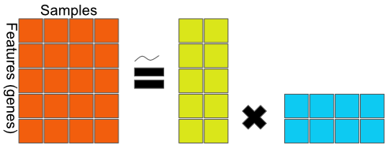
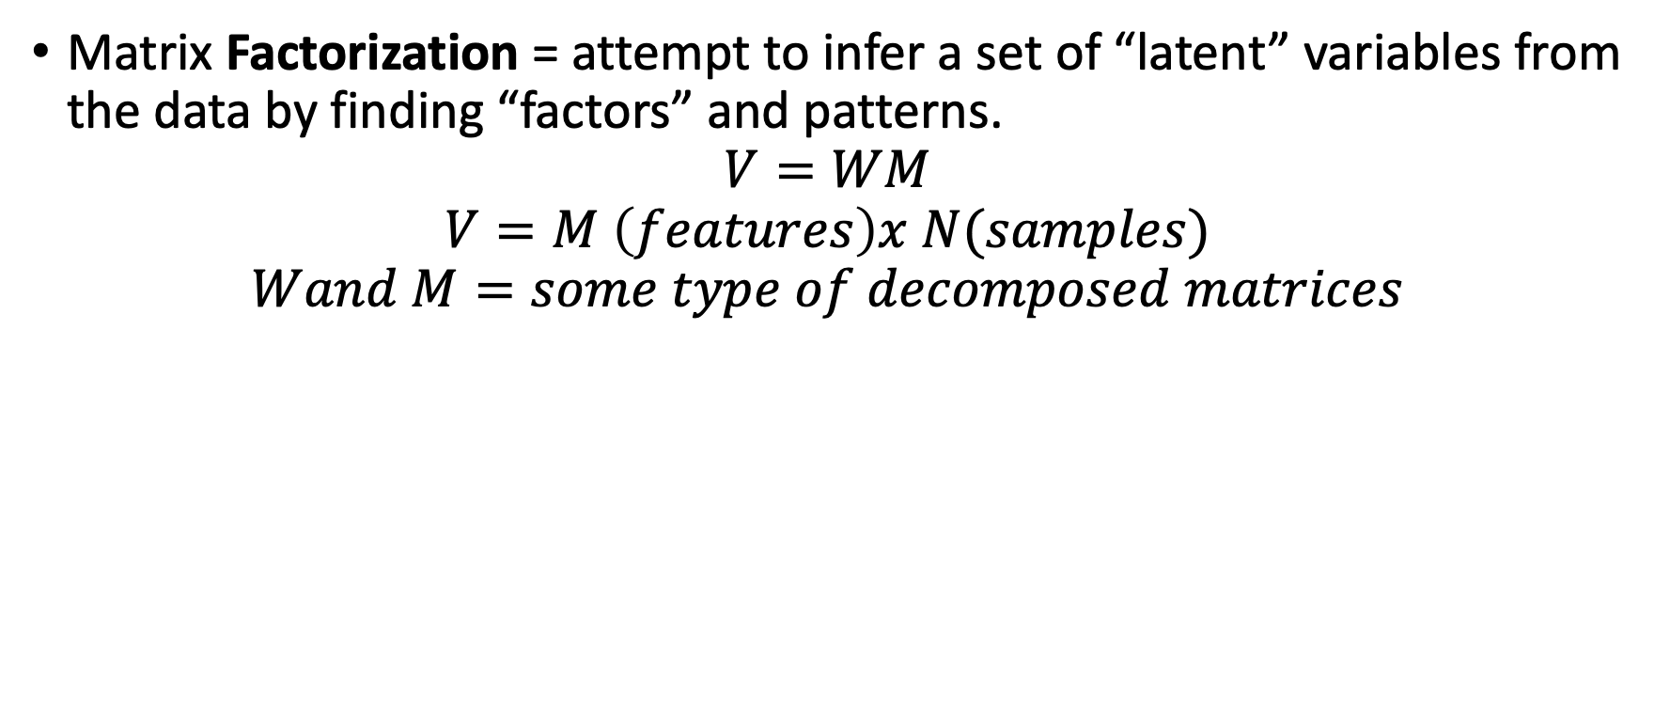
What is NMF? Factorization
Matrix Factorization = attempt to infer a set of “latent” variables from the data by finding “factors” and patterns.
$$V=WM$$
$$V=M \left(features\right)x N(samples)$$
$$Wand M=some type of decomposed matrices$$
Features

Slide 4
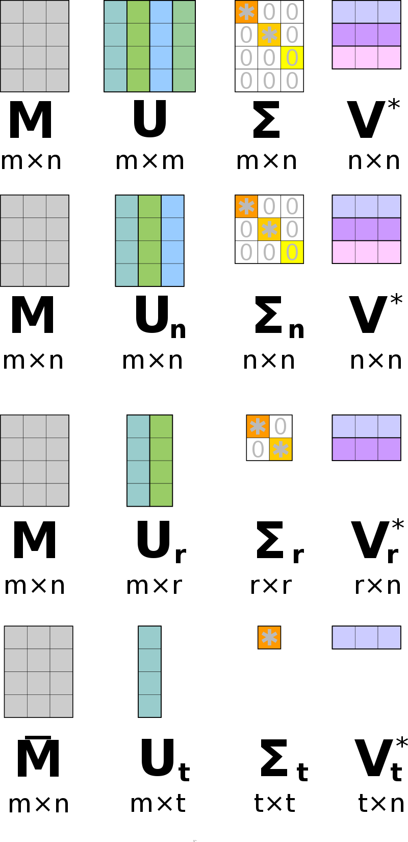
What is NMF? Factorization
Matrix Factorization = attempt to infer a set of “latent” variables from the data by finding “factors” and patterns.
$$V=WM$$
$$V=M \left(features\right)x N(samples)$$
$$Wand M=some type of decomposed matrices$$
Guess the illustration.

Slide 5
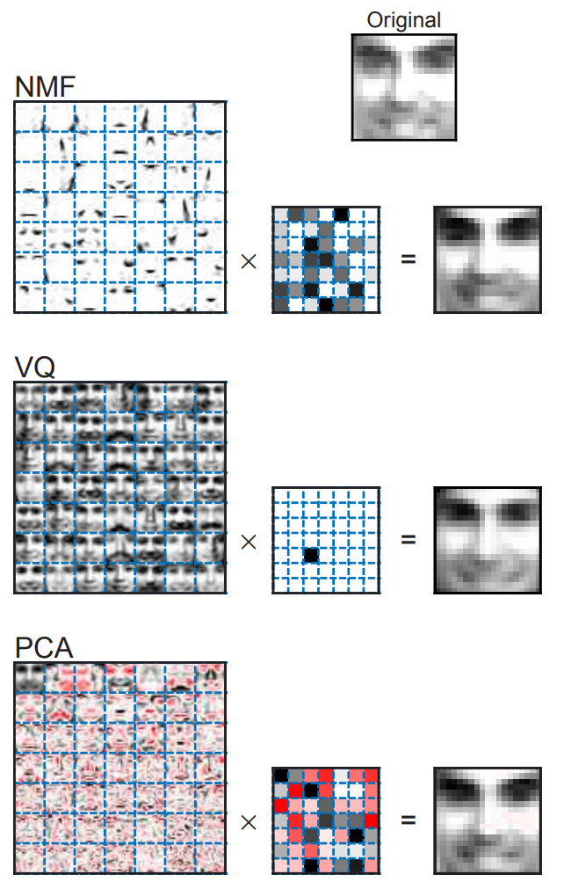
What is NMF?
It’s a factorization of a non-negative variables into two smaller matrices (basis matrix and mixture coefficient matrix).
Basis matrix = metagene, amplitude, source signal
Mixture matrix = metagene expression, pattern, expression profile
Origins: Can we learn a whole from its parts?
Lee DD, Seung HS, 1999. Learning the parts of objects by non-negative matrix factorization.
Notes:
Depending on the application eld, these factors are given di erent names: basis images, metagenes, source signals. In this vignette we equivalently and alternatively use the terms basis matrix or metagenes to refer to matrix W , and mixture coecient matrix and metagene expression proles to refer to matrix H .

Slide 6
Why is NMF?
Discover high order interactions
Dimensionality reduction
Compression
Improve SNR prior to further analysis
Clustering
Source separation

Slide 7
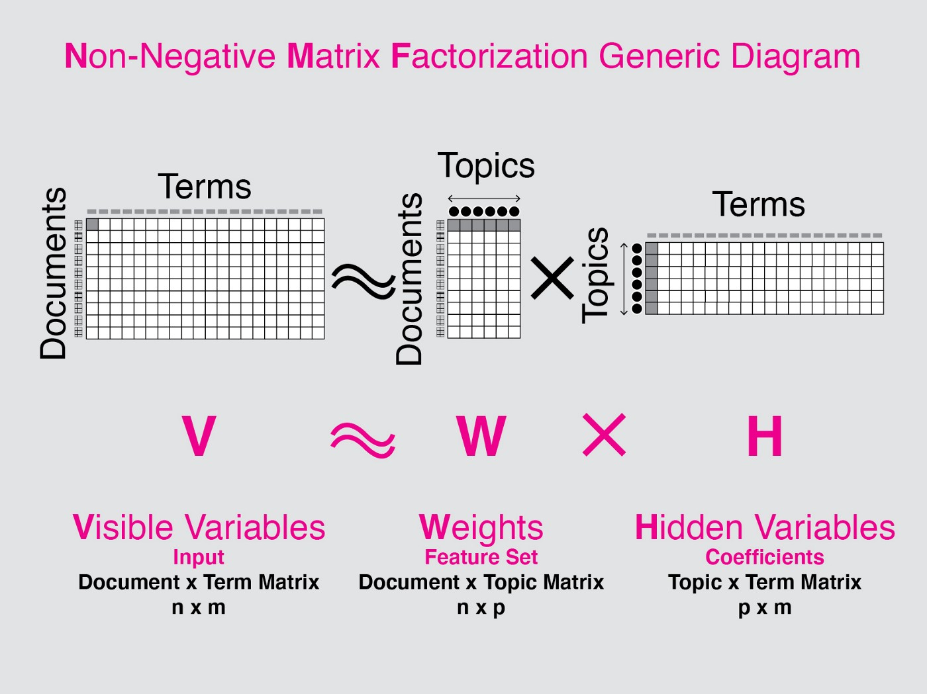
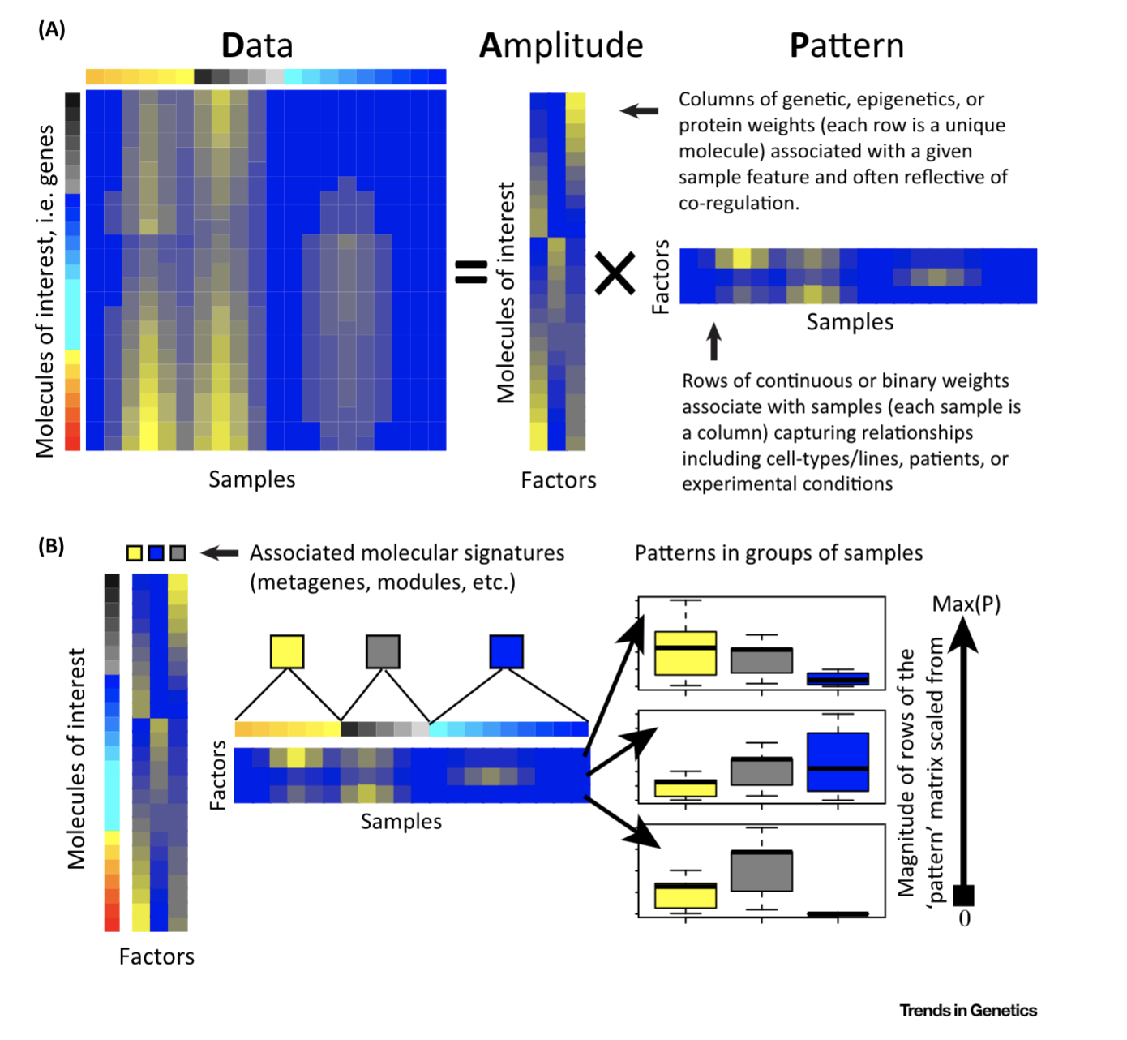
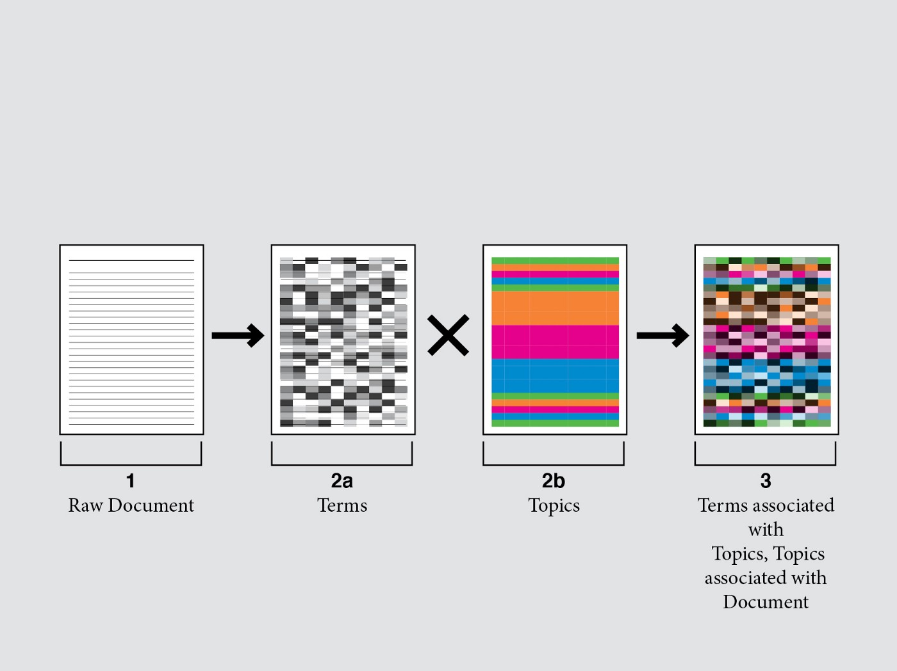
Use cases for NMF
Notes:
words which are similar in meaning occur in similar contexts” (Rubenstein & Goodenough, 1965)’
W is also amplitude
H is also patterns

Slide 8
NMF – Implementation
Non-negativity assumption and data suitability: e.g. firing rate of neurons, counts of an event (trophallaxis), muscle activation. Ensures factors don’t cancel out
Steps - iterative
1. Random initialization of W and H and multiple runs
2. Multiplicative update – fix H and update W and fix W and update X in each iteration
Update matrix such that V - WH = 0 (when one of the matrices is given)
Repeat until convergence – that is, continue until we find that the product of W and H doesn’t get more accurate to describe V
3. Evaluate the solution
Looking at some quality indicators
(e.g. of clustering, residual (V- W*H)
V
=
W
*
H
Notes:
Nonnegativity induces sparsity. • Nonnegativity leads to part-based decompositions
Multiple runs and stability

Slide 9
NMF – Implementation
Algorithm: Many types (Lee, brunet, ls-nmf, Frobenius) - see Berry and Browne, 2007.
Seeding(i.e. value for W and H) – Albright, 2006
random entries from uniform distribution (multiple runs)
ICA, nnsvd, random, none(fixed).
Rank – how many components (k) or r?
Fix components
Iterate and use some quality metric to choose k
Cophenetic Coefficient, RSS curve, silhouette
Notes:
Algorithms and Applications for Approximate Nonnegative Matrix Factorization
Albright2006 seeding Algorithms, initializations, and convergence for the nonnegative matrix factorization
the data scientist must infer the topic from the highest word frequencies per topic, using the H matrix.
Too many, and you have topic repeats or topics composed of sparsely related words. Too few, and you have not very meaningful topics.

Slide 10
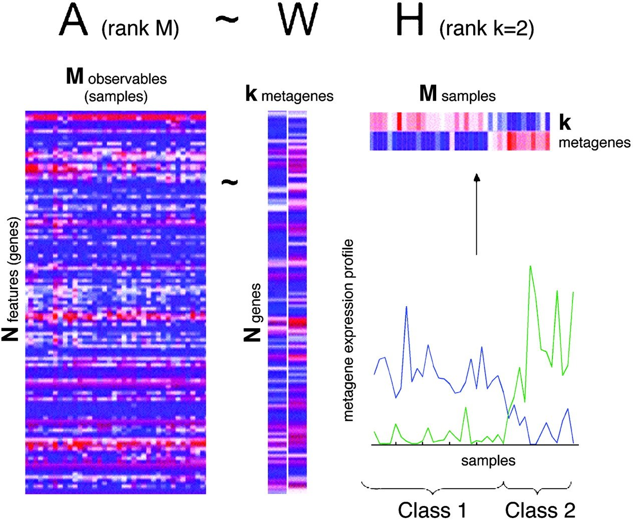
Example 1: Leukaemia Data Set.
The distinction between acute myelogenous leukemia (AML) and acute lymphoblastic leukemia (ALL),
Division of ALL into T and B cell subtypes
(Brunett et al., 2004, Golub et al., 1999)

Slide 11
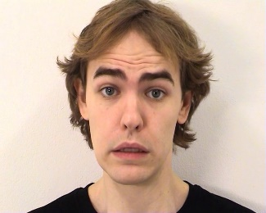
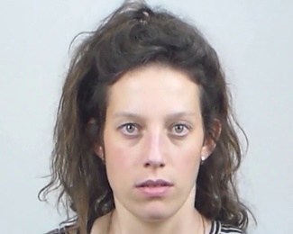
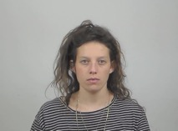
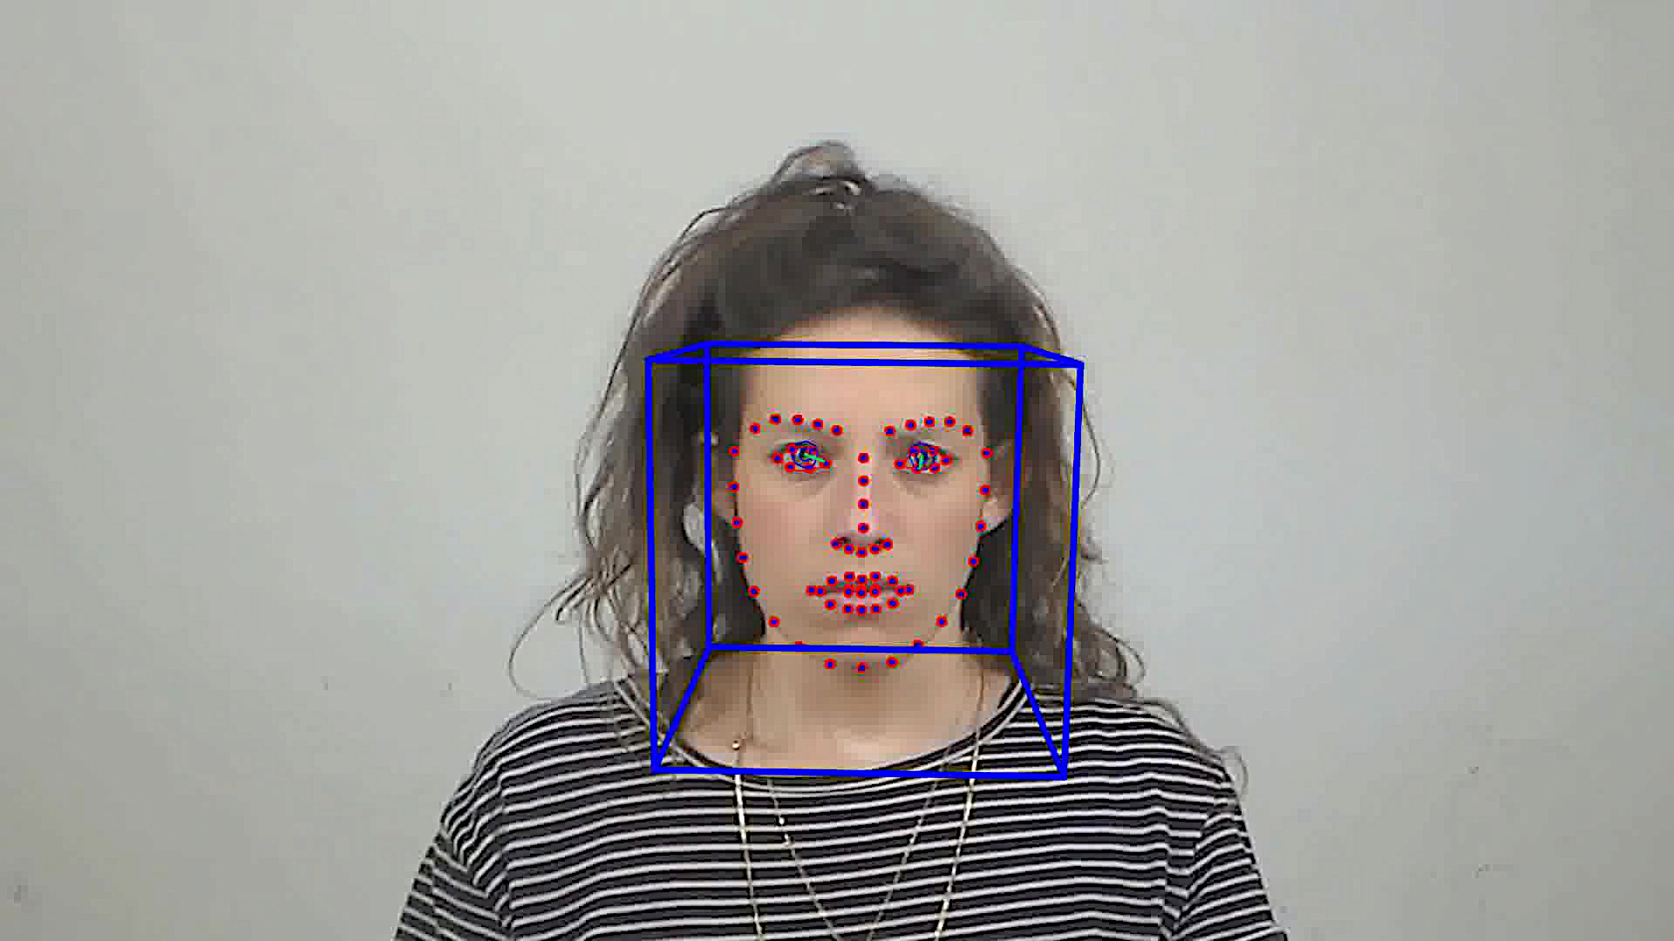
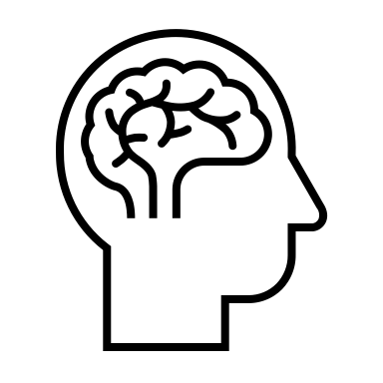
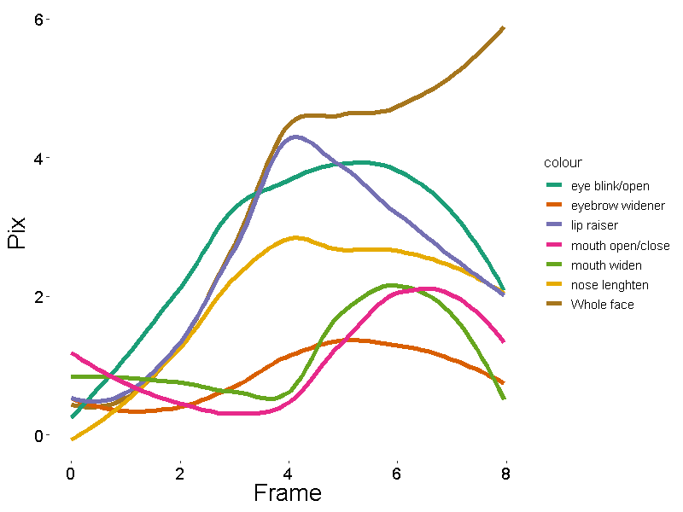
Example 2: learn spatiotemporal structure of facial expressions
High
Low
2 datasets: prototypical vs subtle
Variation in motion dynamics: linear vs non-linear
Different emotions categories
Original/non-linear
Face landmark tracking
Linear
+
=
Valence
Intensity
Recognition
Naturality
AU
Activation

Slide 12
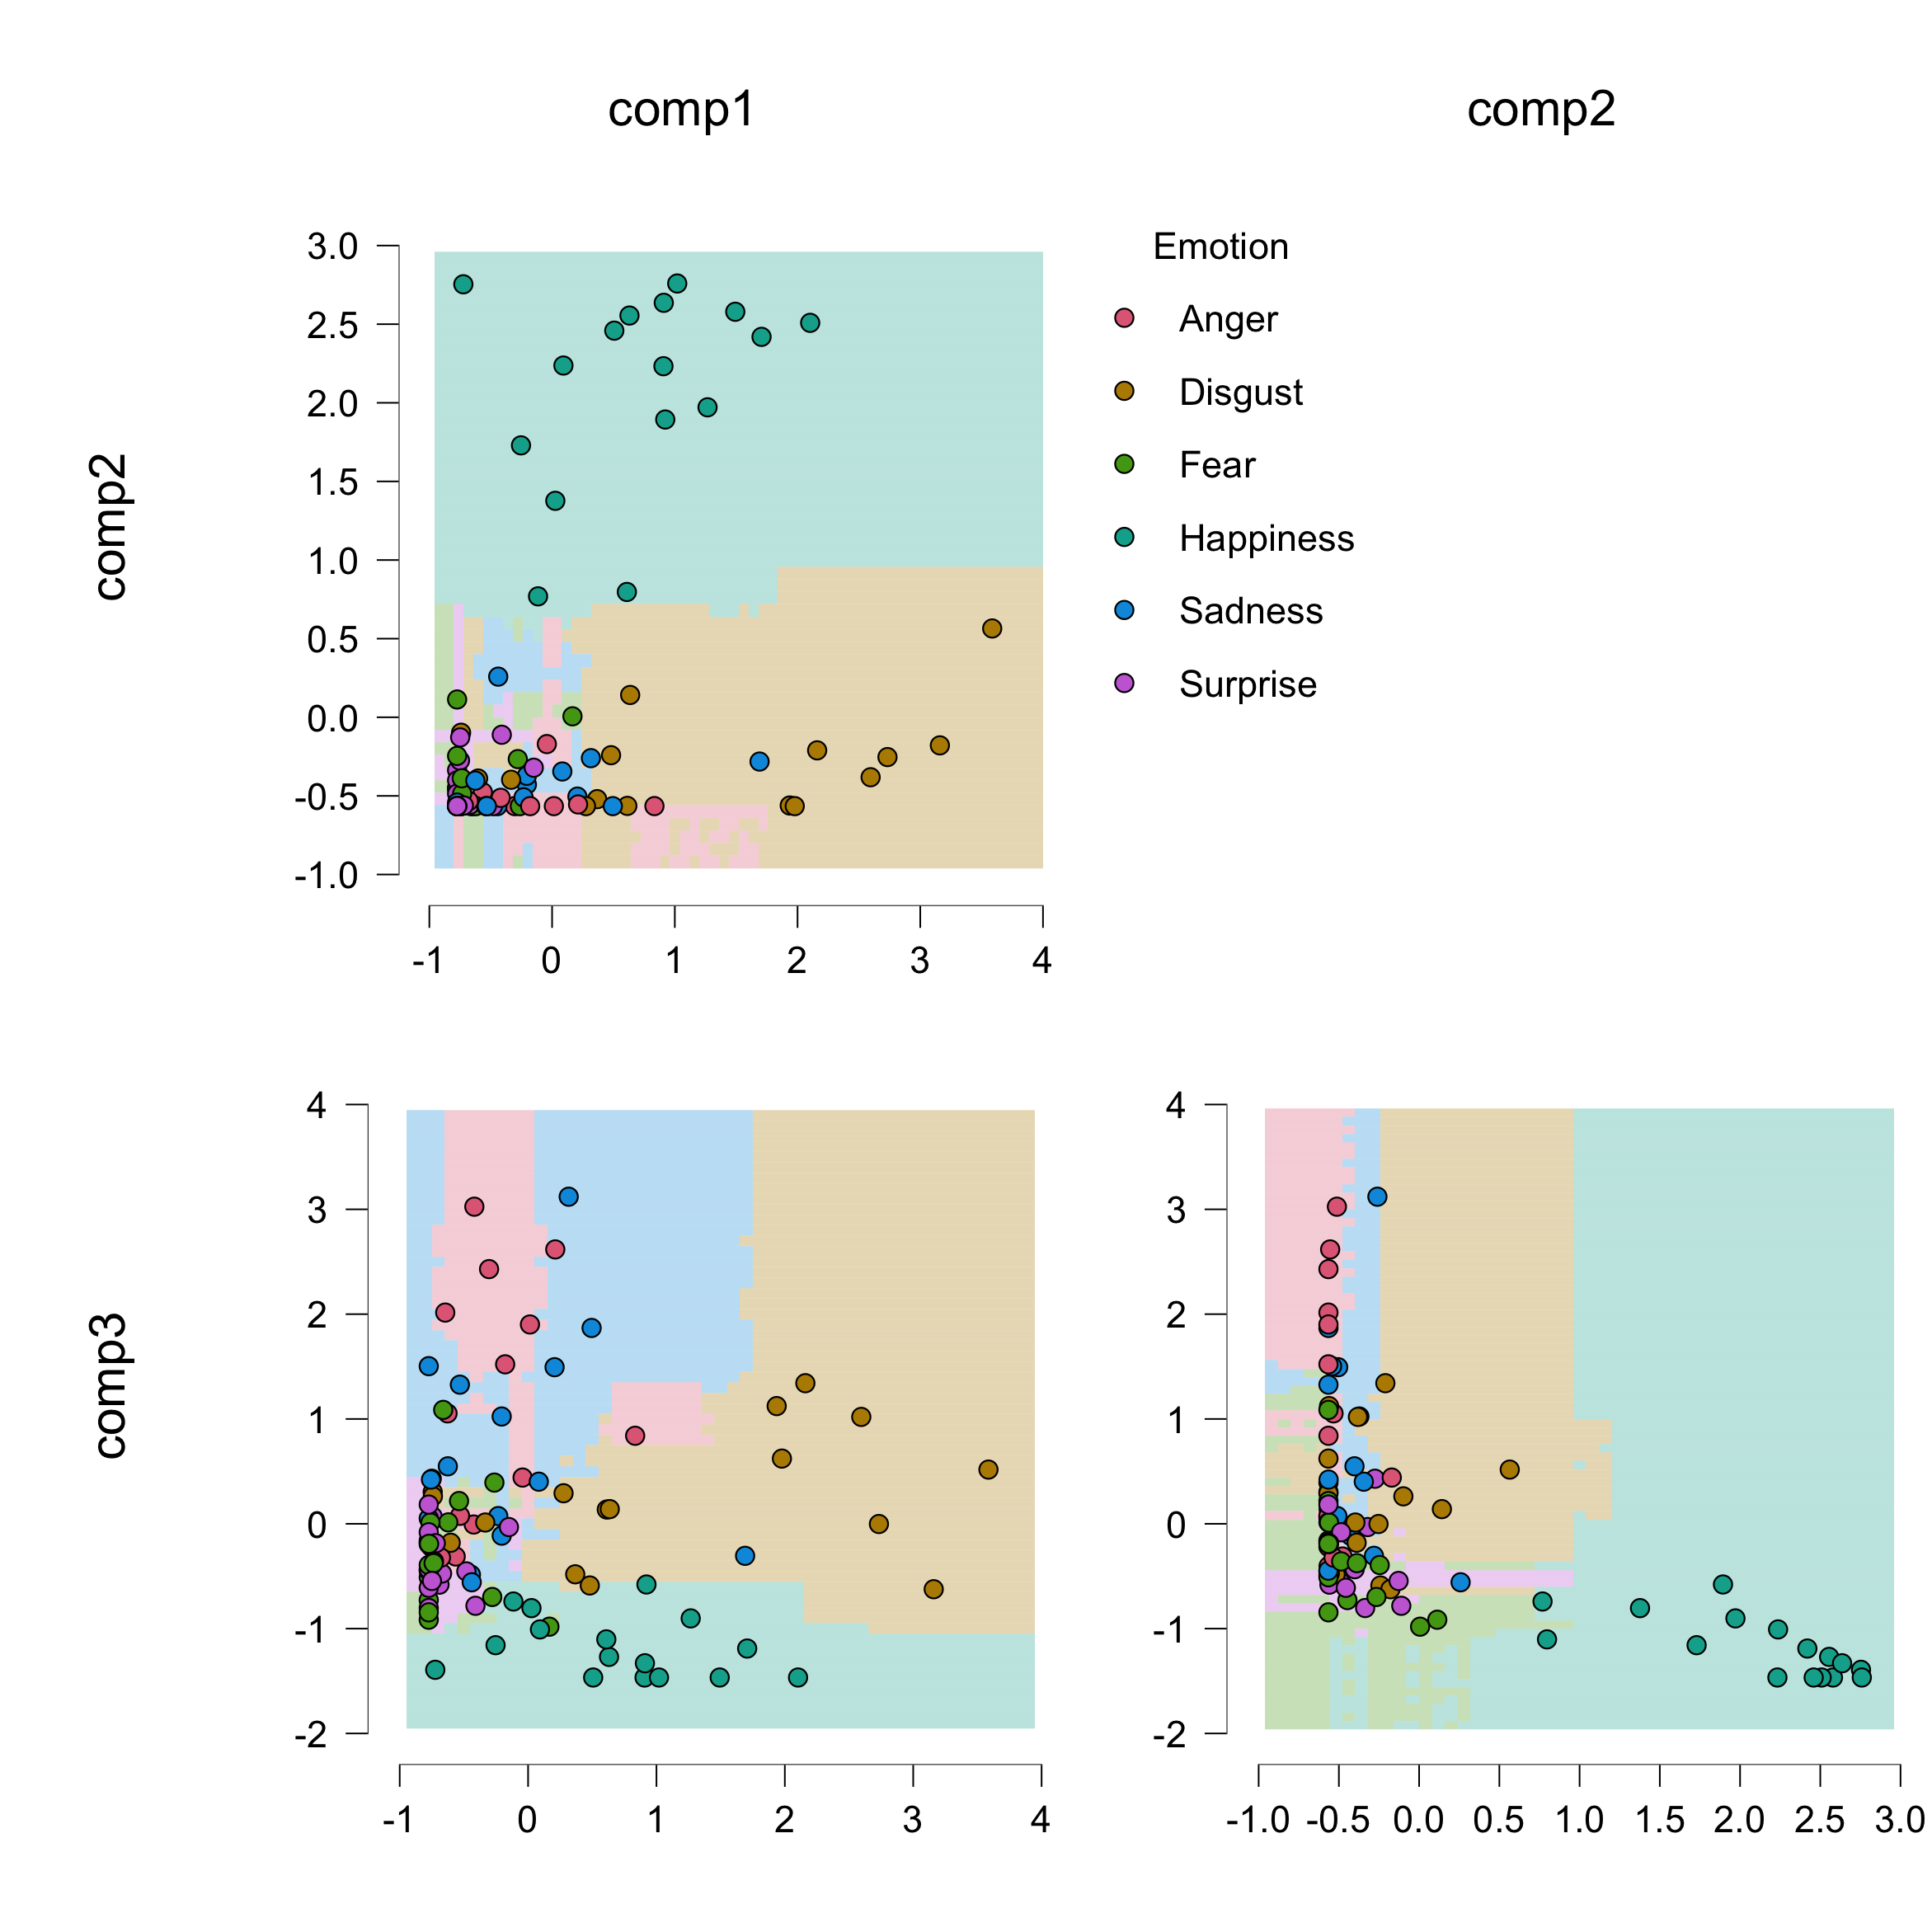
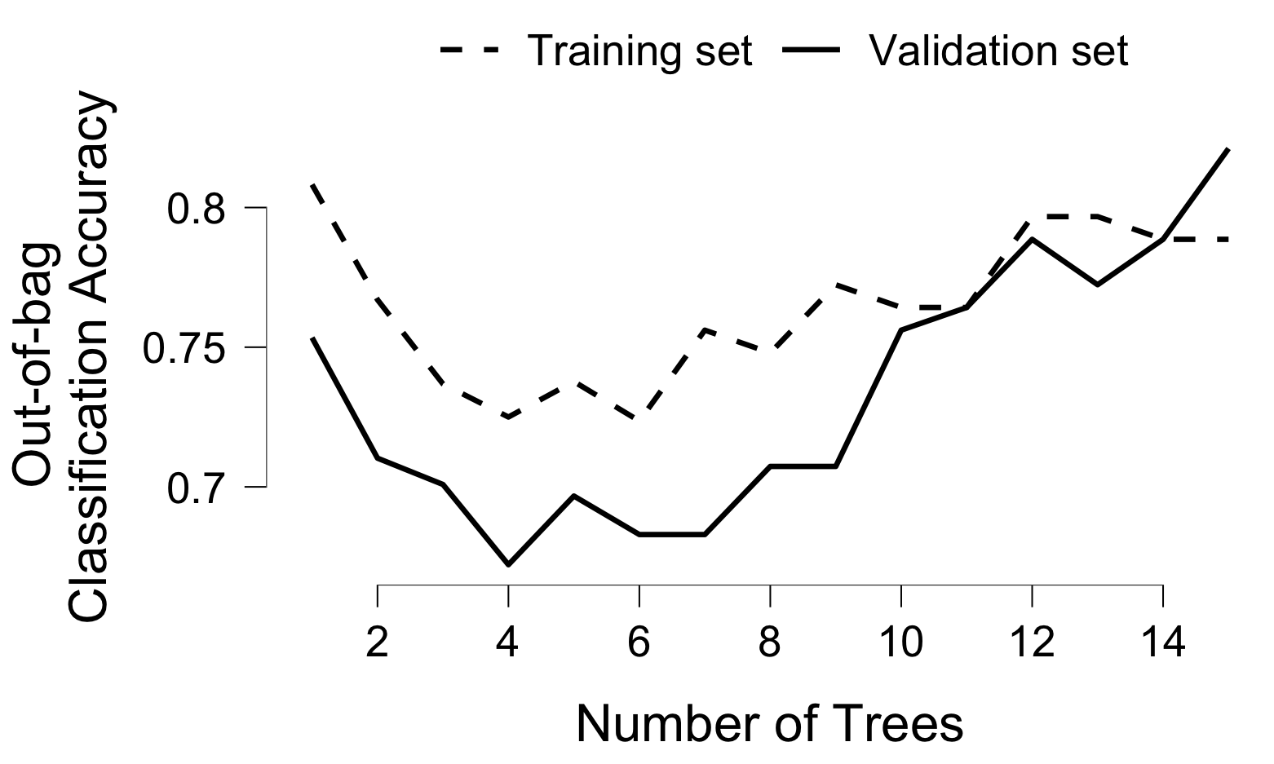
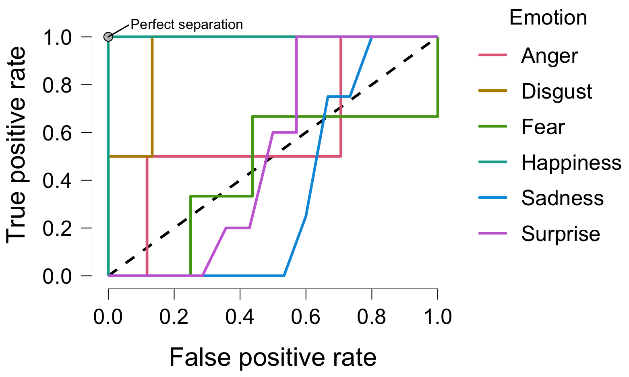
Can we classify emotions with the NMF components
ACC: OBB = .6, training = .3, Validation = .3

Slide 13
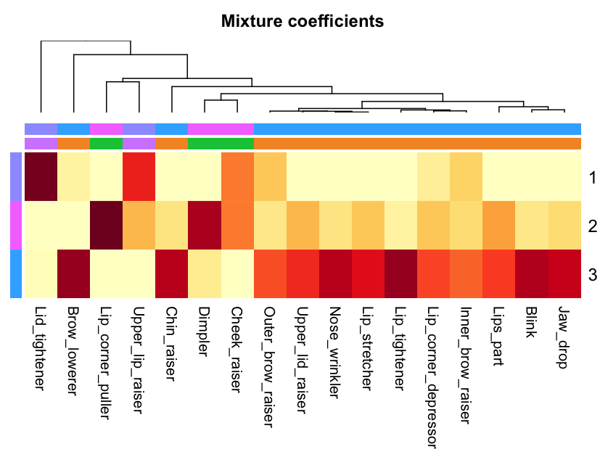
Can we classify emotions with the NMF components
Emotion | Action units
Happiness | 6+12
Sadness | 1+4+15
Surprise | 1+2+5B+26
Fear | 1+2+4+5+7+20+26
Anger | 4+5+7+23
Disgust | 9+15+17
Contempt | R12A+R14A
VS

Slide 14
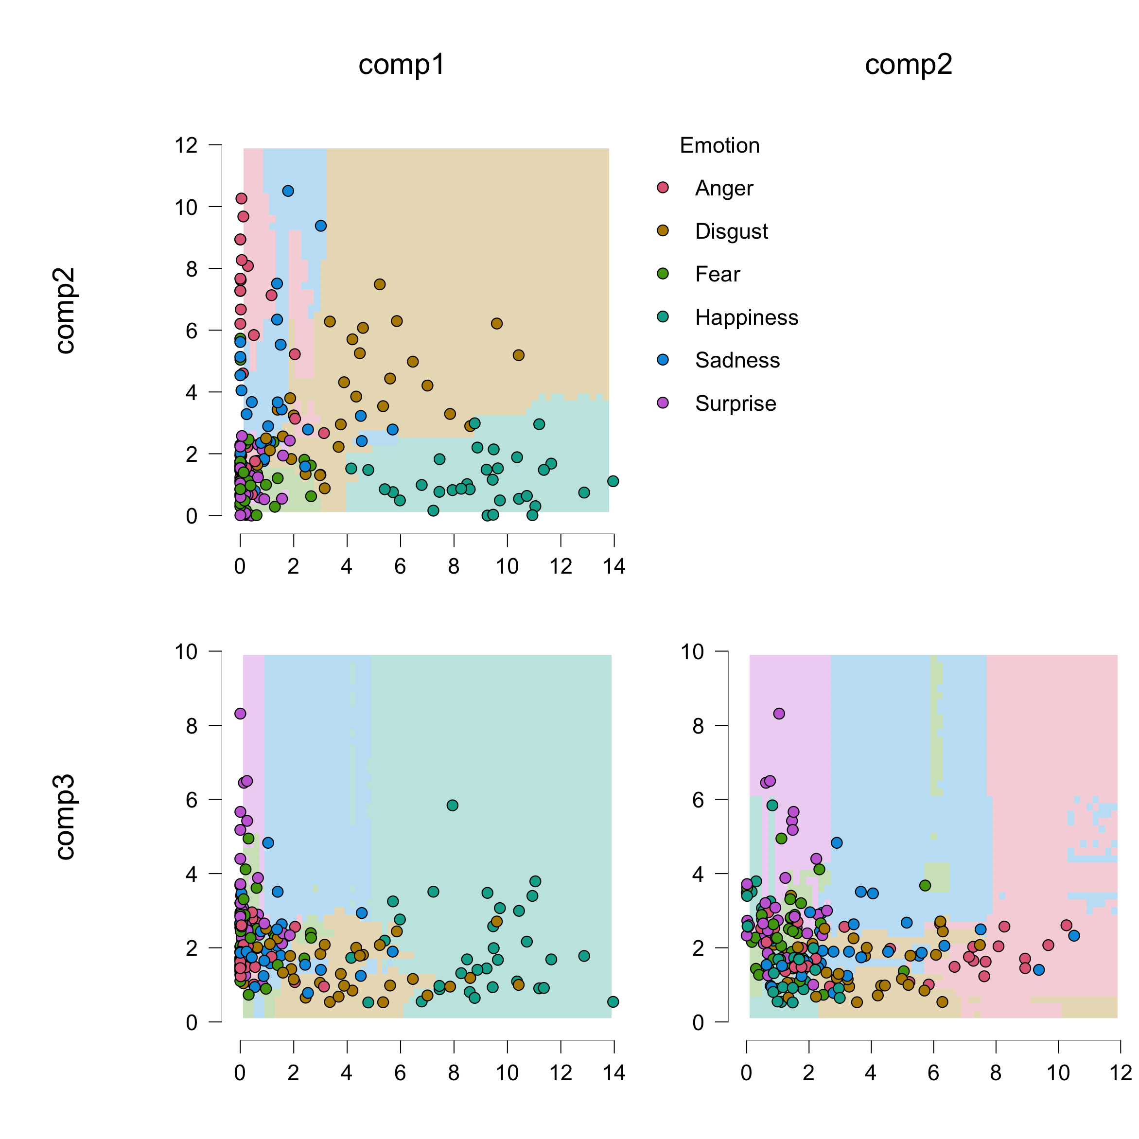
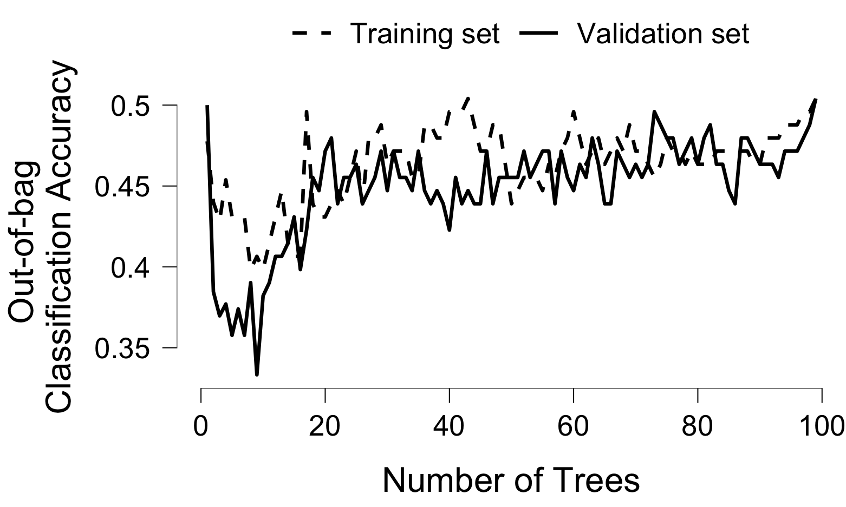
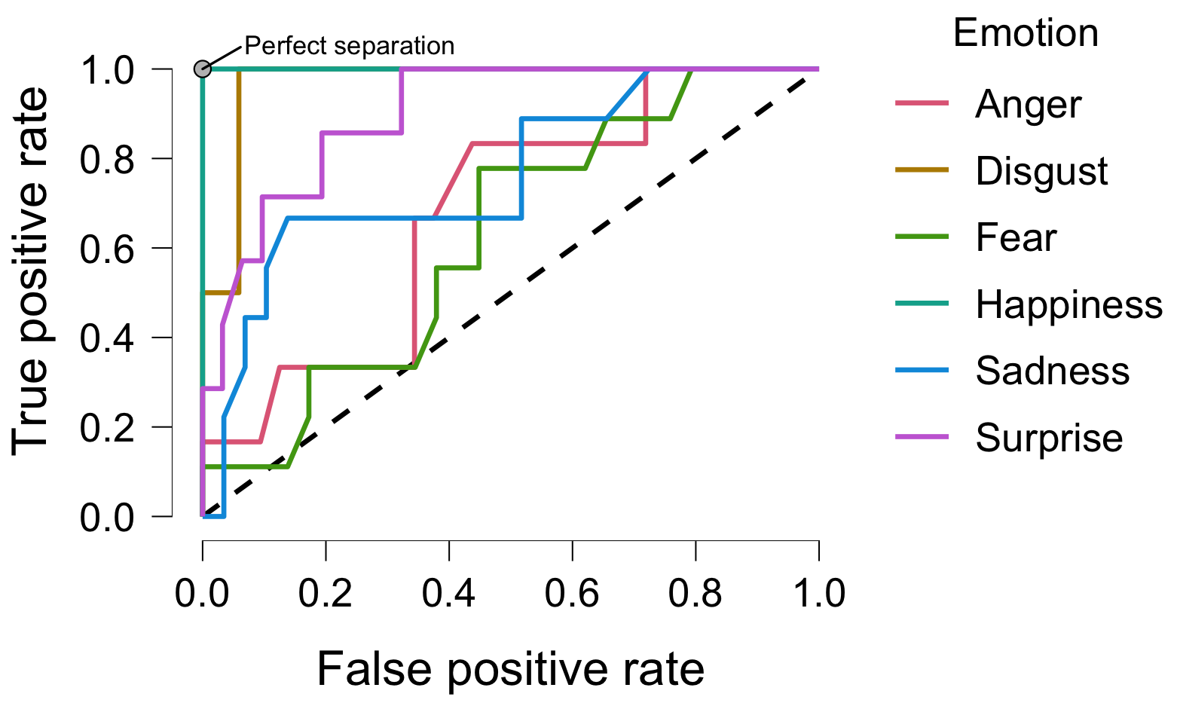
What about learning spatiotemporal structure
Accuracy: OBB = .50,
training = .47, validation = .65

Slide 15
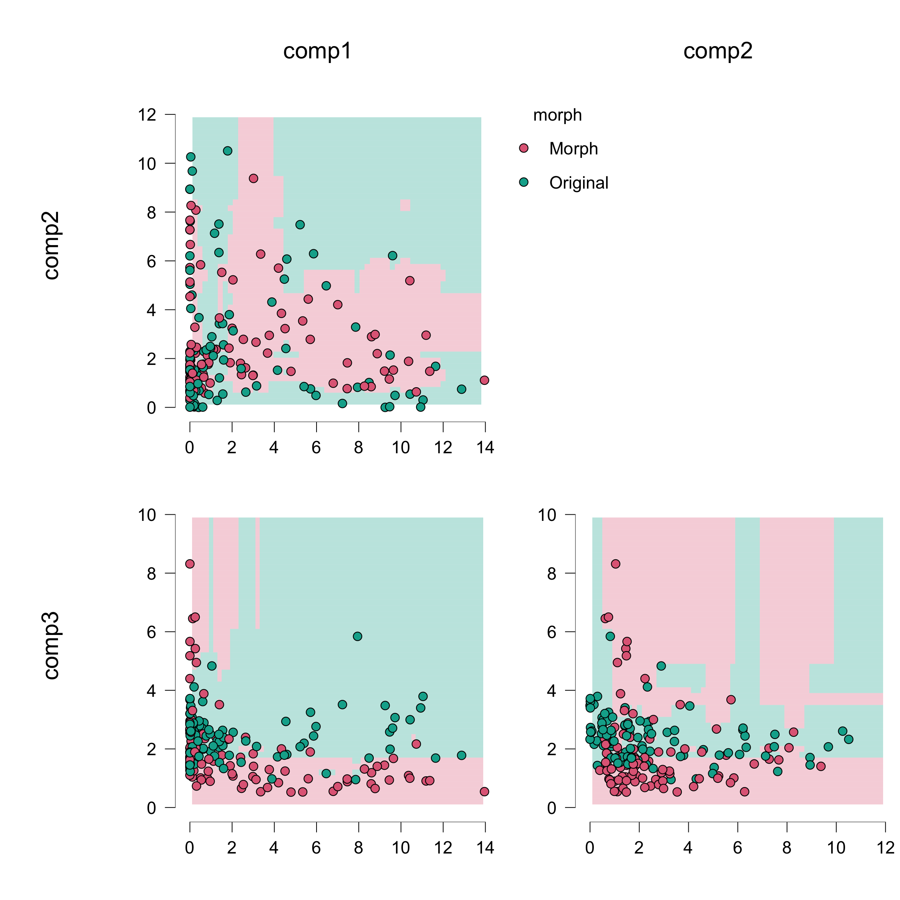
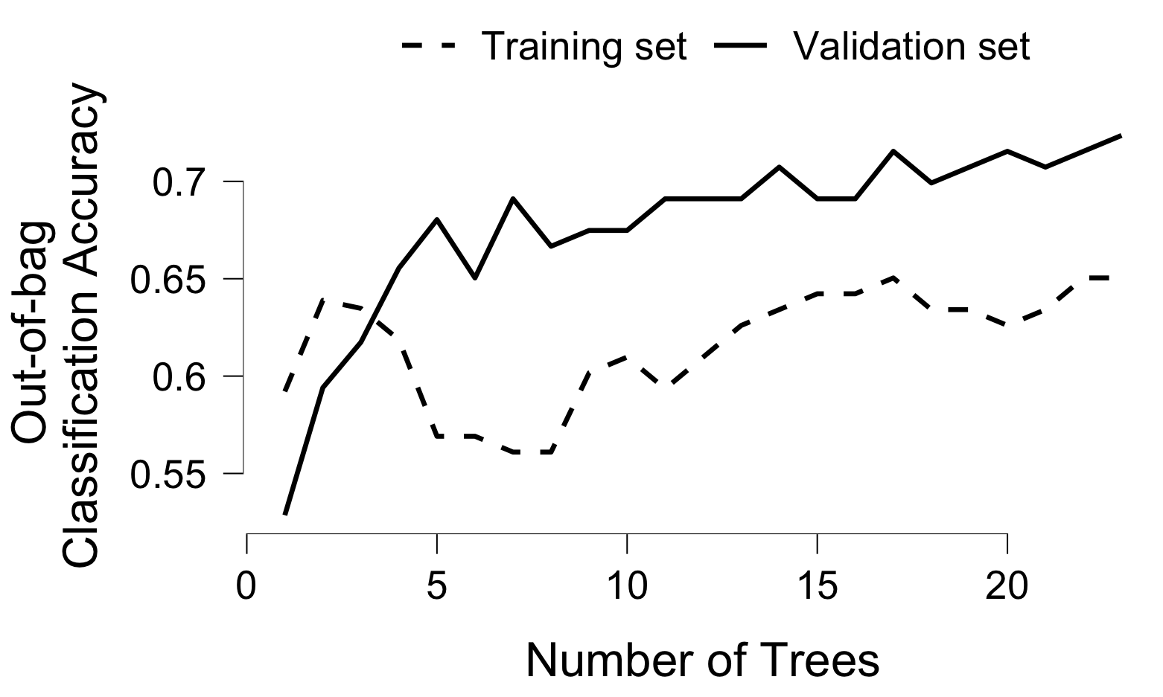
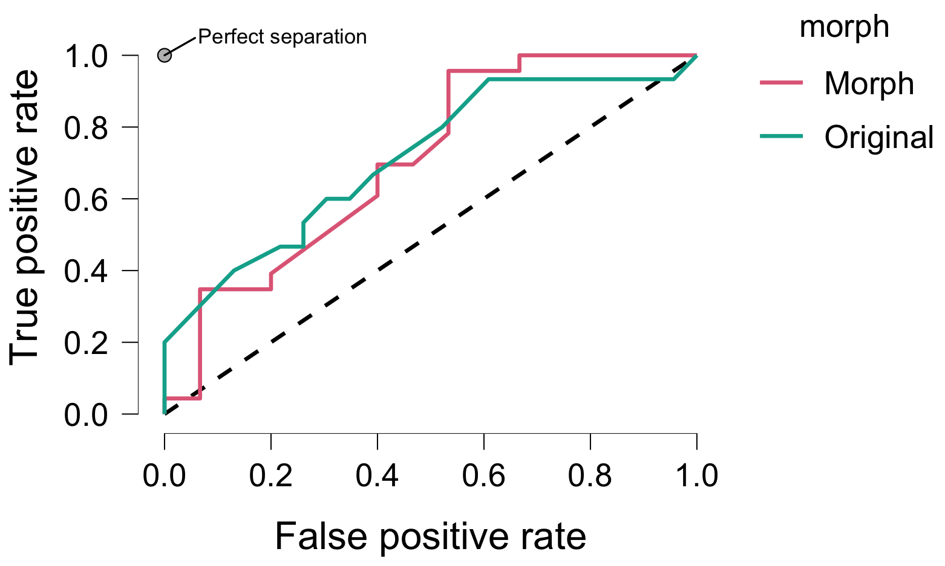
What about learning spatiotemporal structure
Accuracy: OBB = .69,
training = .6, validation = .6

Slide 16
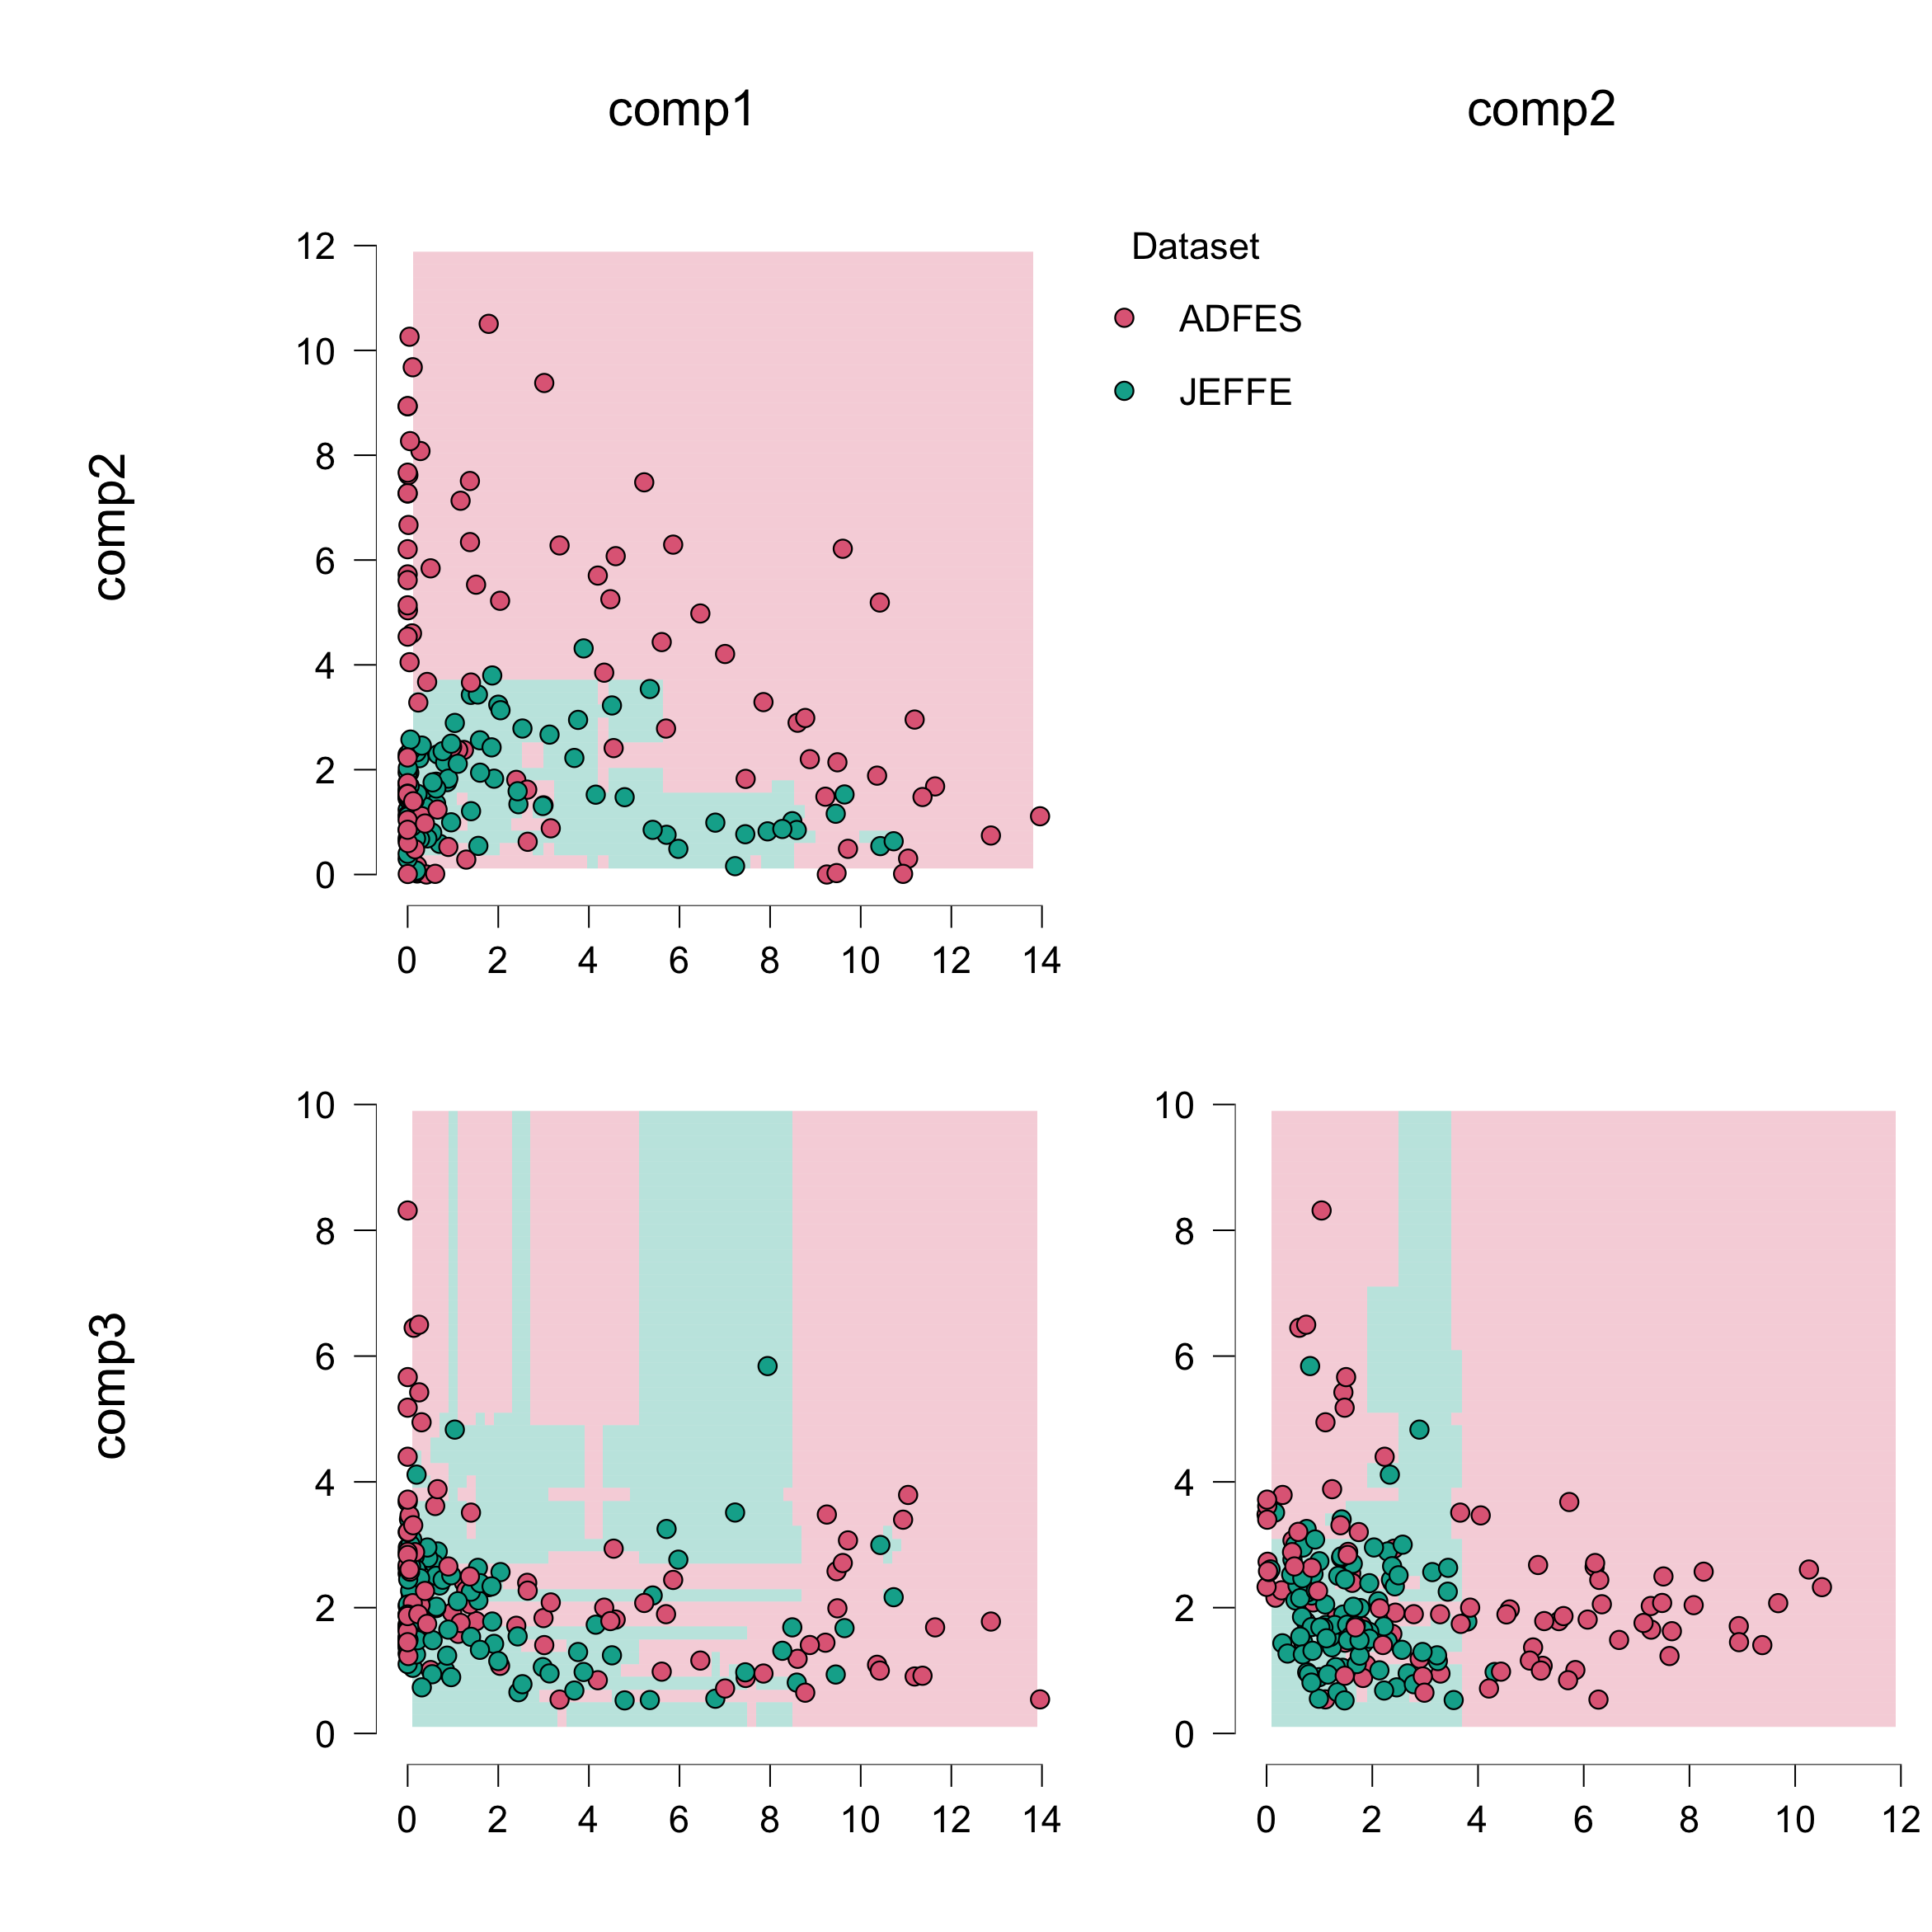
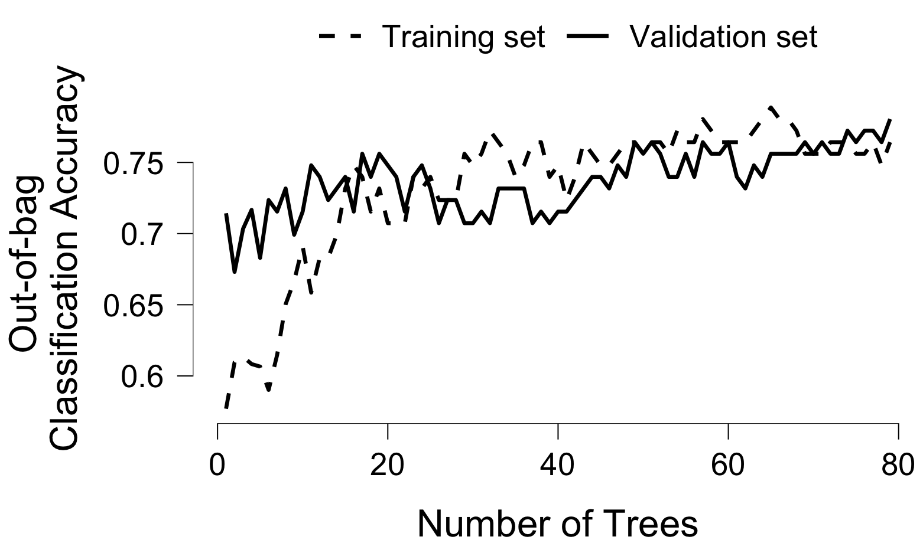
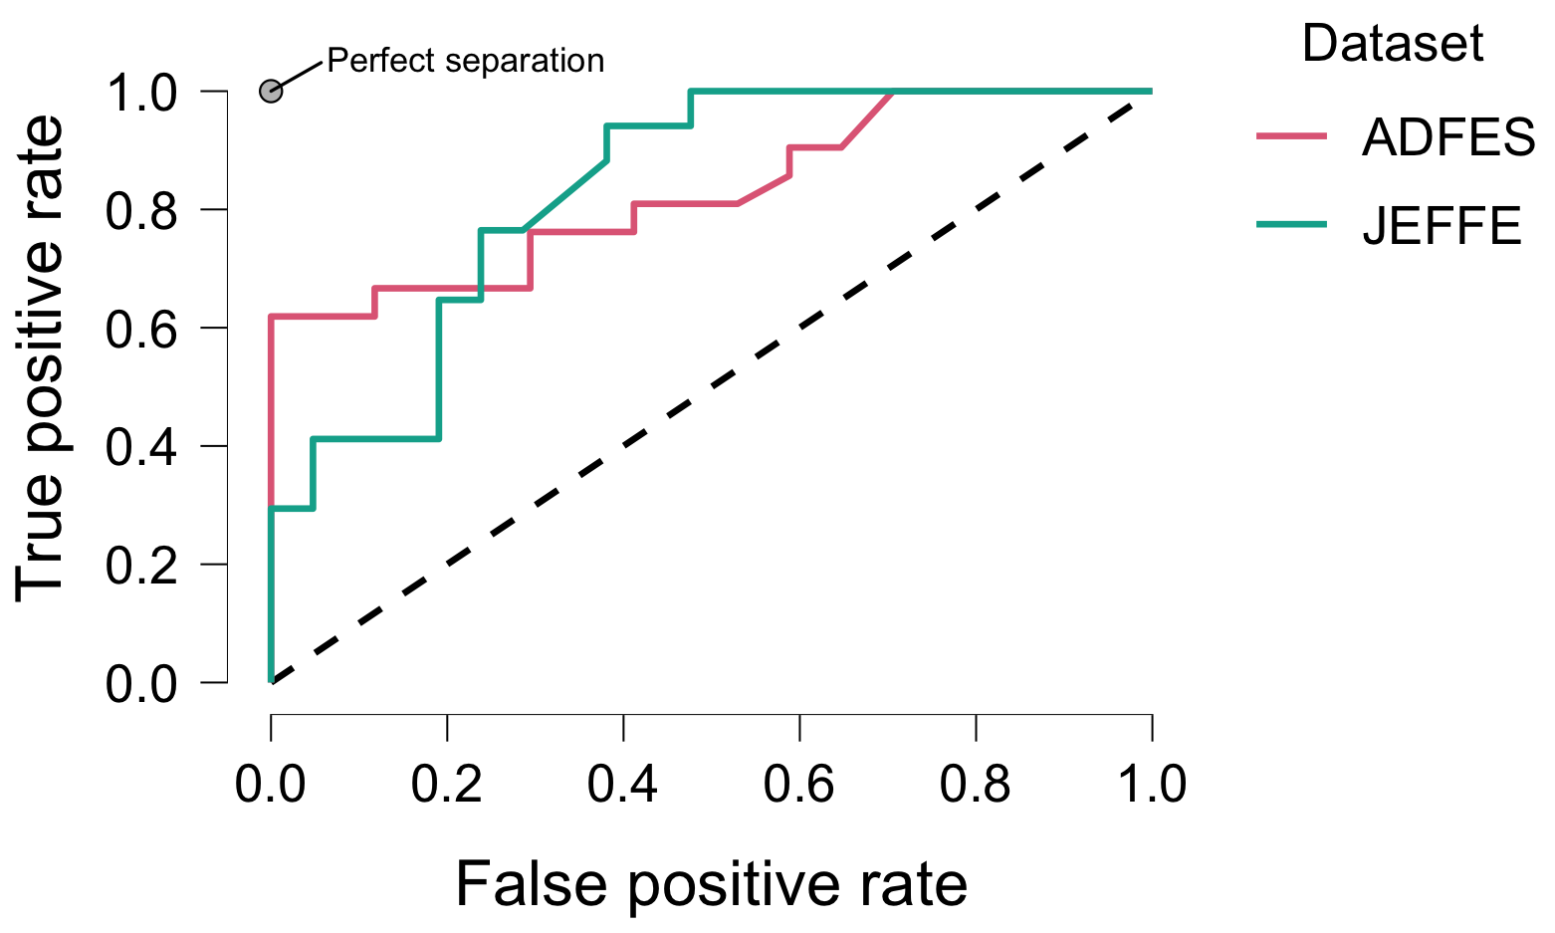
What about learning spatiotemporal structure
Accuracy: OBB = .80,
training = .7, validation = .7

Slide 17
Conclusions
NMF allows learning sparse structures
Non-negativity – benefits for generating, reconstructing plausible data.
Can be combined with other methods: clustering, anovas, etc.

Slide 18
Available tools for implementations
R implementations:
package “NMF” – the most extensive and flexible implementation, and can be customized with new algorithms, visualization functions.
Respective paper
Other R packages:
RcppML: and respective paper
NNLM::nnmf and some vignette
Rsparse for sparse data - vignette

Slide 19
Available tools for implementations
Python:
Pandas, sklearn
sklearn.decomposition.NMF
Matlab
NNMF,
The Non-Negative Matrix Factorization Toolbox in MATLAB (Yifeng Li & Alioune Ngom , 2013)
Also see this listing in stackoverflow
This tutorial will be at https://github.com/hcuve/NMF_Lab_tutorial

Slide 20
Some useful references
Learn parts of objects by non-negative matrix factorization
A flexible R package for nonnegative matrix factorization
Nonnegative matrix factorization for signal and data analytics: [identifiability, algorithms, and applications]
Initializations for the nonnegative matrix factorization
Algorithms and applications for approximate nonnegative matrix factorization
Optimality, computation, and interpretation of nonnegative matrix factorizations
Nonnegative Matrix Factorization: A Comprehensive Review

Slide 21
Limitations
Not great for dissimilar elements, different groups of things/variables
If you are going to cluster genes, then don’t put potatoes next to it
If you want to learn structure of objects, then don’t add words
Comparing faces, you would look at faces from a similar angle, aligned.
Learning temporal structure, then similar durations is important
Non-negativity

